Slide 1
Finding the best area in Toronto for an Indian Restaurant
Capstone Project

Slide 2
Introduction
Toronto is one of the most densely populated areas in Canada. Being the land of opportunity, it brings in a variety of people from different ethnic backgrounds to the core city of Canada, Toronto.
Being the largest city in Canada with an estimated population of over 6 million, there is no doubt about the diversity of the population. Multiculturalism is seen through the various neighborhoods including; Chinatown, Corso Italia, Little India, Kensington Market, Little Italy, Korea town and many more.
Downtown Toronto being the hub of interactions between ethnicities brings many opportunities for entrepreneurs to start or grow their business. It is a place where people can try the best of each culture, either while they work or just passing through. Toronto is well known for its great food
The objective of this project is to use Foursquare location data and regional clustering of venue information to determine what might be the ‘best’ neighborhood in Toronto to open an Indian restaurant.
Through this project, we will find the most suitable location for an entrepreneur to open a new Indian restaurant in Toronto, Canada.

Slide 3
Data Section
Source 1: Toronto Neighborhoods via Wikipedia https://en.wikipedia.org/wiki/List_of_postal_codes_of_Canada:_M
The Wikipedia site shown above provided almost all the information about the neighbourhoods. It included the postal code, borough and the name of the neighborhoods present in Toronto.
Source 2 : Geographical Location data using below CSV file https://cocl.us/Geospatial_data The second source of data provided us with the Geographical coordinates of the neighborhoods with the respective Postal Codes.
Source 3: Venue Data using Foursquare We will need data about different venues in different neighborhoods of that specific borough. In order to gain that information we will use "Foursquare" locational information. Foursquare is a location data provider with information about all manner of venues and events within an area of interest. Such information includes venue names, locations, menus and even photos. As such, the foursquare location platform will be used as the sole data source since all the stated required information can be obtained through the API.

Slide 4
After finding the list of neighborhoods, we then connect to the Foursquare API to gather information about venues inside each and every neighborhood. For each neighborhood, we have chosen the radius to be 100 meter.
The data retrieved from Foursquare contained information of venues within a specified distance of the longitude and latitude of the postcodes. The information obtained per venue as follows:
Neighborhood
Neighborhood Latitude
Neighborhood Longitude
Venue
Name of the venue e.g. the name of a store or restaurant
Venue Latitude
Venue Longitude
Venue Category

Slide 5
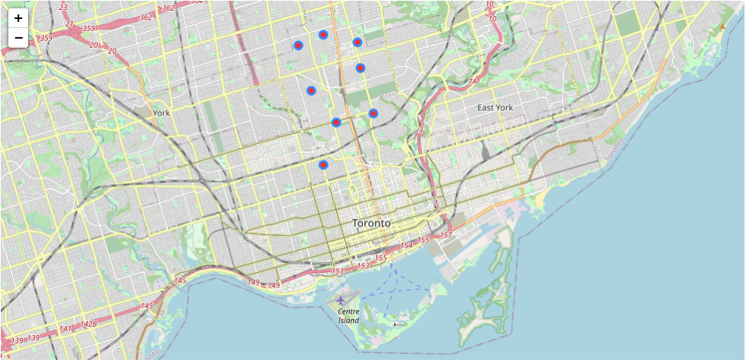
Map of Central Toronto and it's 8 Neighborhood

Slide 6
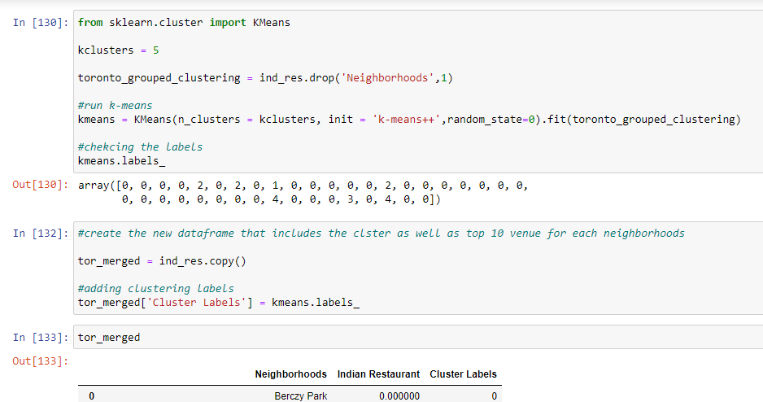
Methodology
To check the Indian restaurant we decided to explore neighborhoods, segment them, and group them into clusters to check in which Neighborhoods Indian restaurants are there and not.
We used K-Means clustering to cluster the neighborhoods based on the neighborhoods that had similar averages of Indian Restaurants in that Neighborhood.

Slide 7
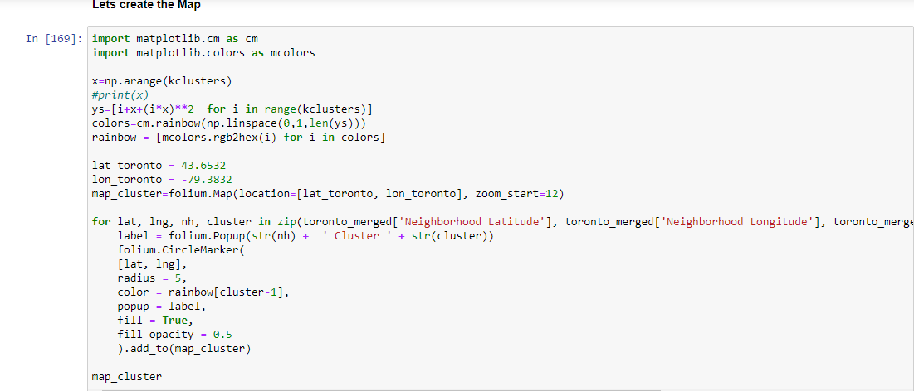
Result Section:

Slide 8
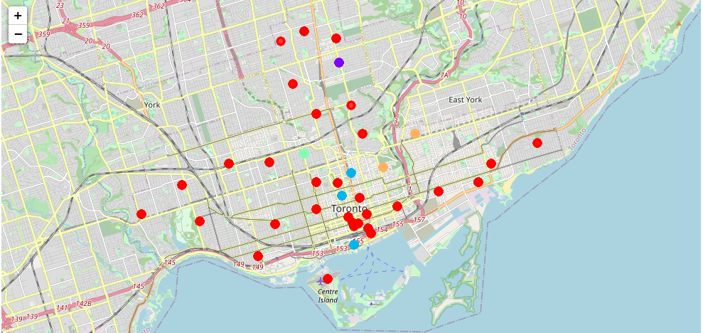
Result Section:

Slide 9
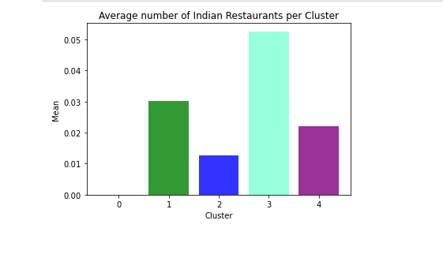
Average number of Indian Restaurant per cluster

Slide 10
Observation
Most of the Indian Restaurants are in cluster 3 represented by the aquamarine colour.
Neighborhood of Central Toronto The Annex, North Midtown, Yorkville is having the highest average of Indian Restaurant.
We see that in the Downtown Toronto area (cluster 2) has the second last average of Indian Restaurants. Looking at the nearby venues, the optimum place to put a new Indian Restaurant is in Downtown Toronto as their are many Neighborhoods in the area but little to no Indian Restaurants therefore, eliminating any competition.
Having 32 neighborhoods in cluster 0, but having no Indian Restaurants provide great opportunity to open Indian Restaurant
This concludes the optimal findings for this project and recommends the entrepreneur to open an authentic Indian restaurant in these locations with little to no competition. Nonetheless, if the food is authentic, affordable and good taste, I am confident that it will have great following everywhere.

